Slide 1
Nine men morris game
Group members: Shubham Kathiriya (Roll no : 2023201050)
Sneha Arora (Roll no: 2023201025)
Soham Kale (Roll no: 2023202018)
Soham Ghosh (Roll no: 2023202011)
Team name: Four Sure
Team number: 29
Instructor/Mentor: Soumitra Ghosh

Slide 2
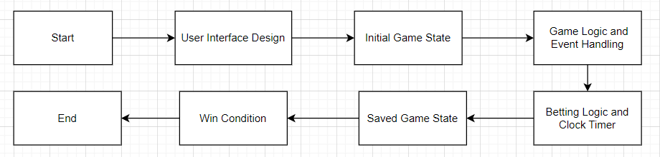
Project workflow

Slide 3
Achieved Project Necessities
Created the game board with 24 points and lines connecting them.
Implemented interactive 'on-click' functionality for cells on the board.
Developed a timer feature for each player that counts down in accordance with the predefined(set by player) betting time. Additionally, integrated the functionality to pause and resume the timer based on the players' turns
Displayed the number of pieces out and number of pieces available for each player.

Slide 4
Pending Project Necessities
Validate and provide visual feedback for piece placement.
Enforce core game rules including mill formation and piece removal.
Validate player moves to prevent rule violations.
Develop an AI with multiple difficulty levels. Utilize minimax algorithm with alpha-beta pruning for decision-making. (optional)

Slide 5
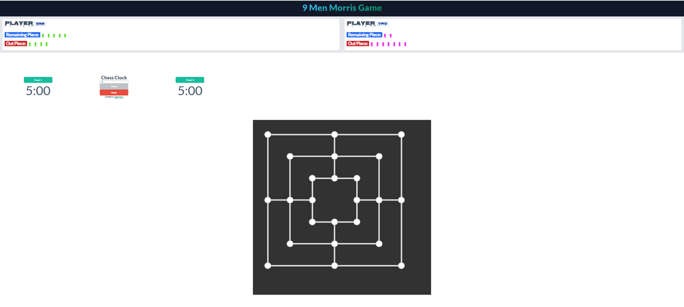
Game Components
Player Header & Timer
Game Board

Slide 6
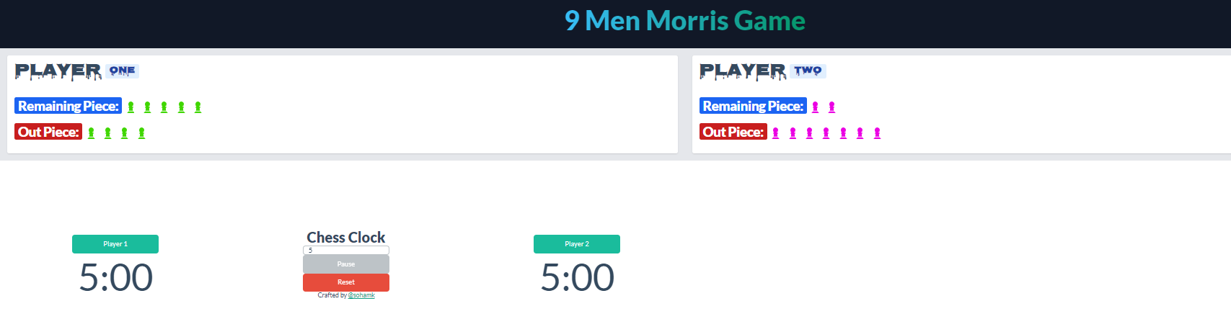
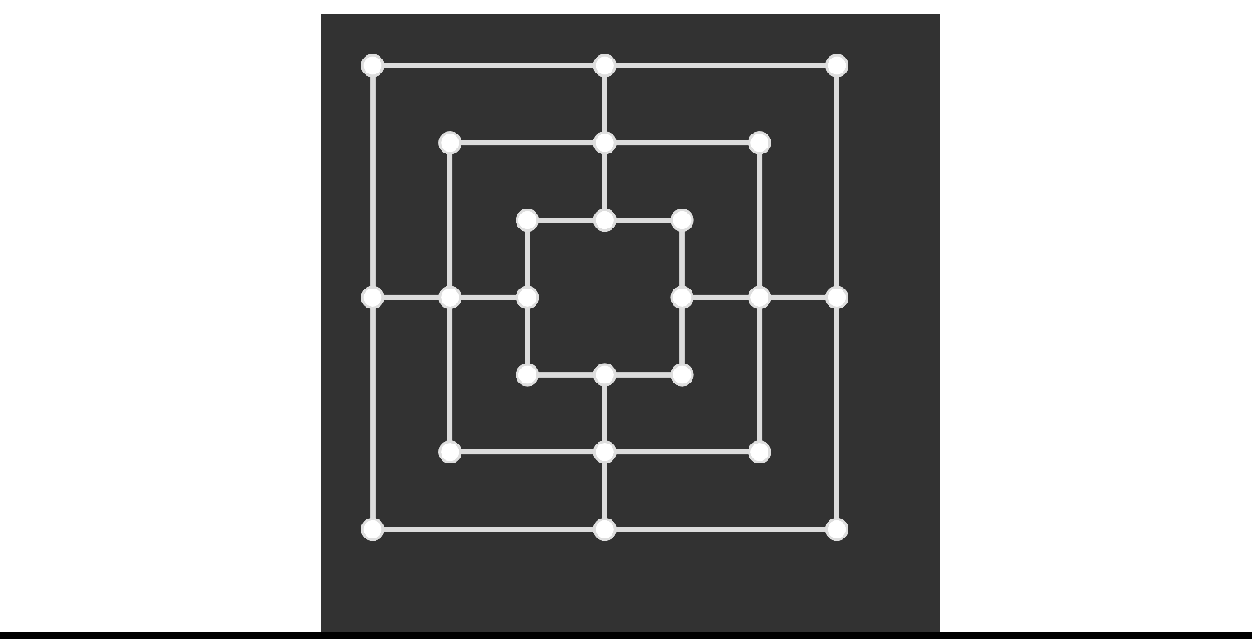
Fully Integrated Game Interface.

Slide 7
Technologies used
HTML
CSS
JavaScript
Canvas

